Slide 1
Airplane Crash Analysis with Power BI
Presented By: Nimra Sultan

Slide 2
CONTENTS
ABOUT THE PROJECT
DATASET DESCRIPTION
IMPORT THE DATA
CLEAN THE DATA
FINAL DASHBOARD
ANALYSIS CONCLUSIONS
ANALYSIS CONCLUSIONS

Slide 3
About the Project
This project analyzes airplane crashes (1980-2023) using Power BI for interactive visualizations.
Dataset includes crash details, fatalities.
Objectives: temporal/geospatial analysis, operator/aircraft performance, fatality trends, route analysis.
Deliverables: Power BI dashboards, reports. Aims to enhance aviation safety.

Slide 4
Dataset Description
Date: Date of the airplane crash.
Time: Time of the airplane crash.
Location: Location where the airplane crash occurred.
Operator: Operator or airline involved in the incident.
Flight #: Flight number associated with the incident.
Route: Planned route of the flight.
AC Type: Aircraft type involved in the crash.
Registration: Registration details of the aircraft.
cn/ln: Construction or serial number of the aircraft.
Aboard: Total number of individuals aboard the aircraft.
Aboard Passengers: Number of passengers aboard the aircraft.
Aboard Crew: Number of crew members aboard the aircraft.
Fatalities: Total fatalities in the incident.
Fatalities Passengers: Number of passenger fatalities.
Fatalities Crew: Number of crew member fatalities.
Ground: Casualties on the ground, if any.
Summary: Summary or description of the incident.

Slide 5
Import the Data

Slide 6
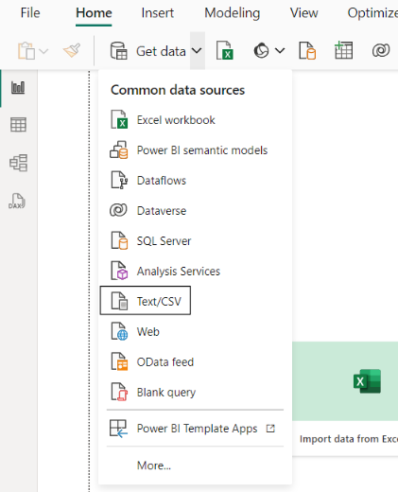
Import Data as CSV File:

Slide 7
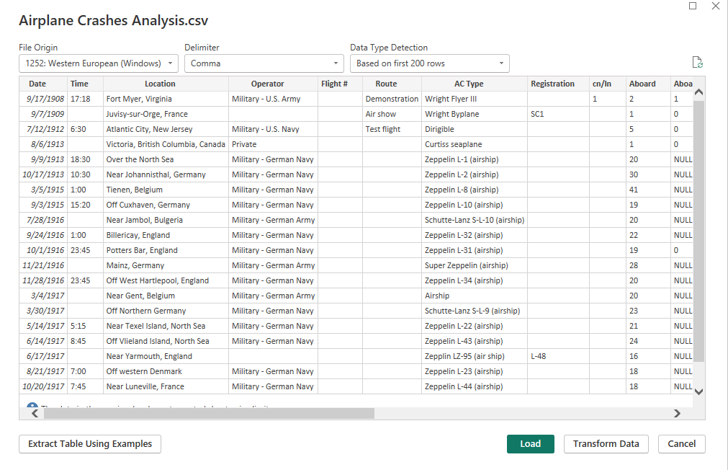
Clean the Data

Slide 8
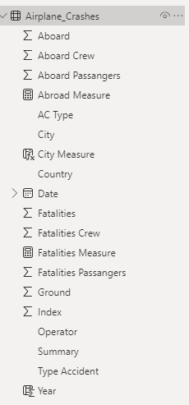

Clean the Data
Remove Empty Value.
Change Data Type.
Replace Inconsistent Value. Rename Some Column.
Apply Change to visualize

Slide 9


Project Objectives:
Temporal Analysis
Geospatial Analysis
Operator Performance
Aircraft Analysis
Fatality Trends
Route Analysis

Slide 10
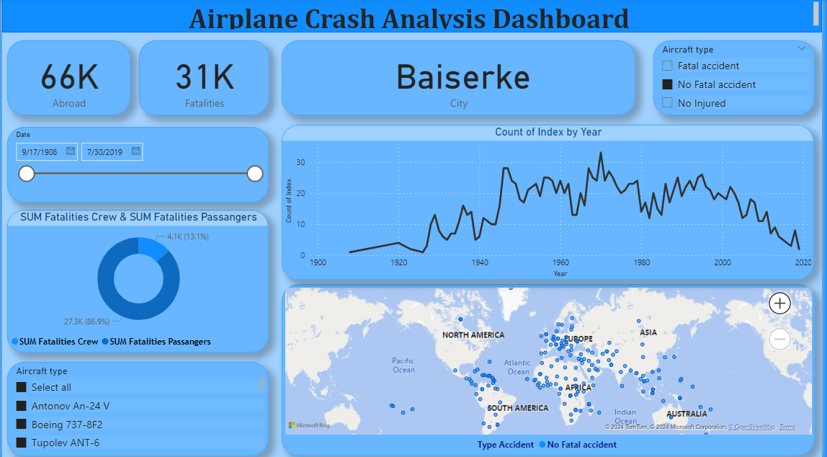
FINAL DASHBOARD

Slide 11
Analysis Conclusions

Slide 12
Analysis Conclusions
Chicago O'Hare, Illinois, especially along route (Chicago, IL- Los Angeles, CA), has the highest airplane fatality rate in the world.
The year 2001 was the highest airplane fatalities rate in the world.
There is a relationship between the Registration details of the aircraft (N110AA), AC Type: McDonnell Douglas DC-10-10 and the number of fatalities.
There is a relationship between operator: American Airlines with serial number(46510/22) and the number of fatalities.

Slide 13
What I Learn
How and when to use different type of visualizations.
How uncleaning data can make your visualization unreadable.

Slide 14
THANKS!

